Slide 1
Unidrv(Pscript) Plugin Introduction
Notes:
WinHEC 2006
© 2006 Microsoft Corporation. All rights reserved. Microsoft, Windows, Windows Vista and other product names are or may be registered trademarks and/or trademarks in the U.S. and/or other countries.
The information herein is for informational purposes only and represents the current view of Microsoft Corporation as of the date of this presentation. Because Microsoft must respond to changing market conditions, it should not be interpreted to be a commitment on the part of Microsoft, and Microsoft cannot guarantee the accuracy of any information provided after the date of this presentation.
MICROSOFT MAKES NO WARRANTIES, EXPRESS, IMPLIED OR STATUTORY, AS TO THE INFORMATION IN THIS PRESENTATION.

Slide 2

Outline
Interface Overview
UI Plug-ins
Render plug-ins
IPrintCoreHelper for Plug-Ins
Release
Notes:
WinHEC 2006
© 2006 Microsoft Corporation. All rights reserved. Microsoft, Windows, Windows Vista and other product names are or may be registered trademarks and/or trademarks in the U.S. and/or other countries.
The information herein is for informational purposes only and represents the current view of Microsoft Corporation as of the date of this presentation. Because Microsoft must respond to changing market conditions, it should not be interpreted to be a commitment on the part of Microsoft, and Microsoft cannot guarantee the accuracy of any information provided after the date of this presentation.
MICROSOFT MAKES NO WARRANTIES, EXPRESS, IMPLIED OR STATUTORY, AS TO THE INFORMATION IN THIS PRESENTATION.

Slide 3
Interface Overview
Interface | UI Plug-in | Render Plug-in | Unidrv | Pscript5
IPrintOemUI | ■ |  | ■ | ■
IPrintOemUI2 | ■ |  | ■ | ■
IPrintOemDriverUI | ■ |  | ■ | ■
IPrintCoreUI2 | ■ |  |  | ■
IPrintOemPrintTicketProvider | ■ |  | ■ | ■
IPrintCoreHelper | ■ | ■ | ■ | ■
IPrintOemUni |  | ■ | ■
IPrintOemUni2 |  | ■ | ■
IPrintOemUni3 |  | ■ | ■
IPrintOemDriverUni |  | ■ | ■
IPrintCoreHelperUni |  | ■ | ■
IPrintOemPS |  | ■ |  | ■
IPrintOemPS2 |  | ■ |  | ■
IPrintOemDriverPS |  | ■ |  | ■
IPrintCorePS2 |  | ■ |  | ■
IPrintCoreHelperPS |  | ■ |  | ■
Notes:
WinHEC 2006
© 2006 Microsoft Corporation. All rights reserved. Microsoft, Windows, Windows Vista and other product names are or may be registered trademarks and/or trademarks in the U.S. and/or other countries.
The information herein is for informational purposes only and represents the current view of Microsoft Corporation as of the date of this presentation. Because Microsoft must respond to changing market conditions, it should not be interpreted to be a commitment on the part of Microsoft, and Microsoft cannot guarantee the accuracy of any information provided after the date of this presentation.
MICROSOFT MAKES NO WARRANTIES, EXPRESS, IMPLIED OR STATUTORY, AS TO THE INFORMATION IN THIS PRESENTATION.

Slide 4
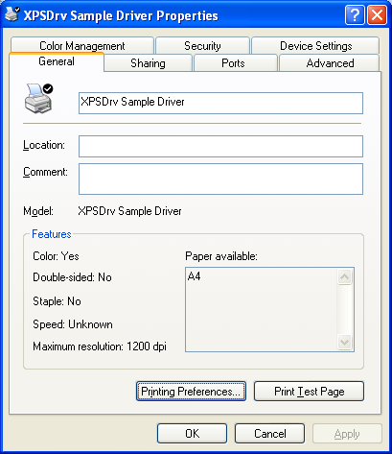


UI Plug-ins
Introduction
  Printer Property
Notes:
WinHEC 2006
© 2006 Microsoft Corporation. All rights reserved. Microsoft, Windows, Windows Vista and other product names are or may be registered trademarks and/or trademarks in the U.S. and/or other countries.
The information herein is for informational purposes only and represents the current view of Microsoft Corporation as of the date of this presentation. Because Microsoft must respond to changing market conditions, it should not be interpreted to be a commitment on the part of Microsoft, and Microsoft cannot guarantee the accuracy of any information provided after the date of this presentation.
MICROSOFT MAKES NO WARRANTIES, EXPRESS, IMPLIED OR STATUTORY, AS TO THE INFORMATION IN THIS PRESENTATION.

Slide 5
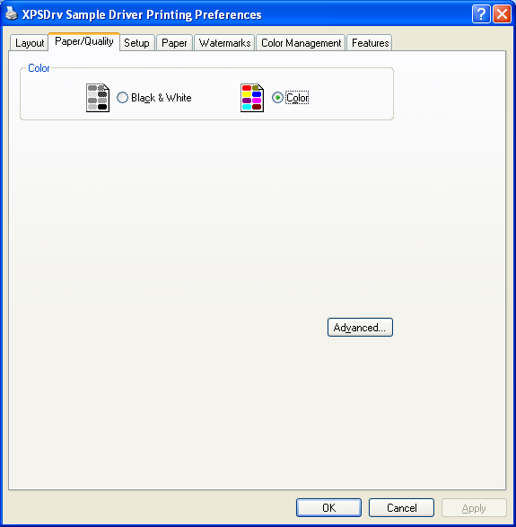
UI Plug-ins
Introduction
  Document Property
Notes:
WinHEC 2006
© 2006 Microsoft Corporation. All rights reserved. Microsoft, Windows, Windows Vista and other product names are or may be registered trademarks and/or trademarks in the U.S. and/or other countries.
The information herein is for informational purposes only and represents the current view of Microsoft Corporation as of the date of this presentation. Because Microsoft must respond to changing market conditions, it should not be interpreted to be a commitment on the part of Microsoft, and Microsoft cannot guarantee the accuracy of any information provided after the date of this presentation.
MICROSOFT MAKES NO WARRANTIES, EXPRESS, IMPLIED OR STATUTORY, AS TO THE INFORMATION IN THIS PRESENTATION.

Slide 6
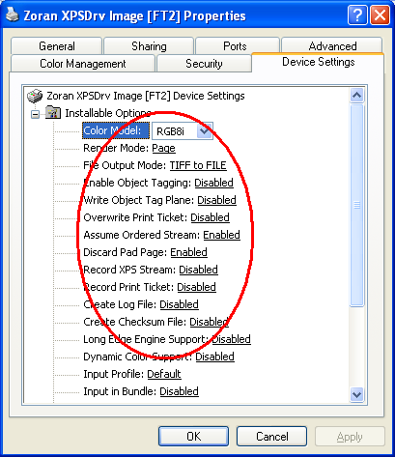
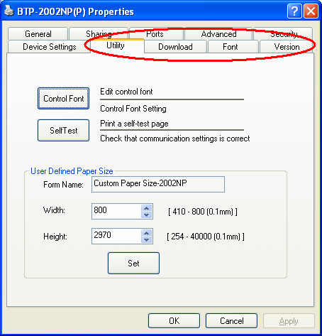

UI Plug-ins
Introduction
  IPrintOemUI
  1. Add Remove Replace items on the Printer Property(Device Setting), or Add a new Printer Property
Notes:
WinHEC 2006
© 2006 Microsoft Corporation. All rights reserved. Microsoft, Windows, Windows Vista and other product names are or may be registered trademarks and/or trademarks in the U.S. and/or other countries.
The information herein is for informational purposes only and represents the current view of Microsoft Corporation as of the date of this presentation. Because Microsoft must respond to changing market conditions, it should not be interpreted to be a commitment on the part of Microsoft, and Microsoft cannot guarantee the accuracy of any information provided after the date of this presentation.
MICROSOFT MAKES NO WARRANTIES, EXPRESS, IMPLIED OR STATUTORY, AS TO THE INFORMATION IN THIS PRESENTATION.

Slide 7
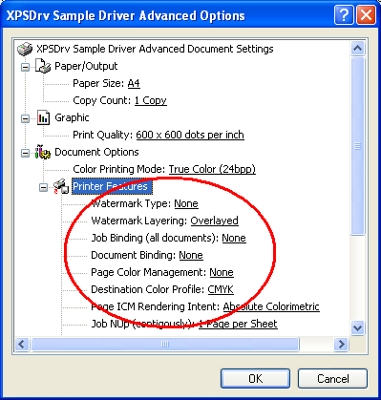
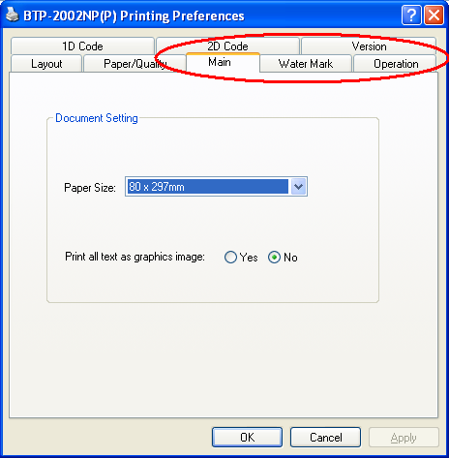
UI Plug-ins
Introduction
  IPrintOemUI
  2. Add Remove Replace items on the Document Property (Layout Paper/Quality Advanced), or Add a new Document Property
Notes:
WinHEC 2006
© 2006 Microsoft Corporation. All rights reserved. Microsoft, Windows, Windows Vista and other product names are or may be registered trademarks and/or trademarks in the U.S. and/or other countries.
The information herein is for informational purposes only and represents the current view of Microsoft Corporation as of the date of this presentation. Because Microsoft must respond to changing market conditions, it should not be interpreted to be a commitment on the part of Microsoft, and Microsoft cannot guarantee the accuracy of any information provided after the date of this presentation.
MICROSOFT MAKES NO WARRANTIES, EXPRESS, IMPLIED OR STATUTORY, AS TO THE INFORMATION IN THIS PRESENTATION.

Slide 8
UI Plug-ins
Introduction
  IPrintOemUI
  3. Processing some Print Event, as DrvPrinterEvent does
  4. Report the Current Capabilities about this printer
Notes:
WinHEC 2006
© 2006 Microsoft Corporation. All rights reserved. Microsoft, Windows, Windows Vista and other product names are or may be registered trademarks and/or trademarks in the U.S. and/or other countries.
The information herein is for informational purposes only and represents the current view of Microsoft Corporation as of the date of this presentation. Because Microsoft must respond to changing market conditions, it should not be interpreted to be a commitment on the part of Microsoft, and Microsoft cannot guarantee the accuracy of any information provided after the date of this presentation.
MICROSOFT MAKES NO WARRANTIES, EXPRESS, IMPLIED OR STATUTORY, AS TO THE INFORMATION IN THIS PRESENTATION.

Slide 9
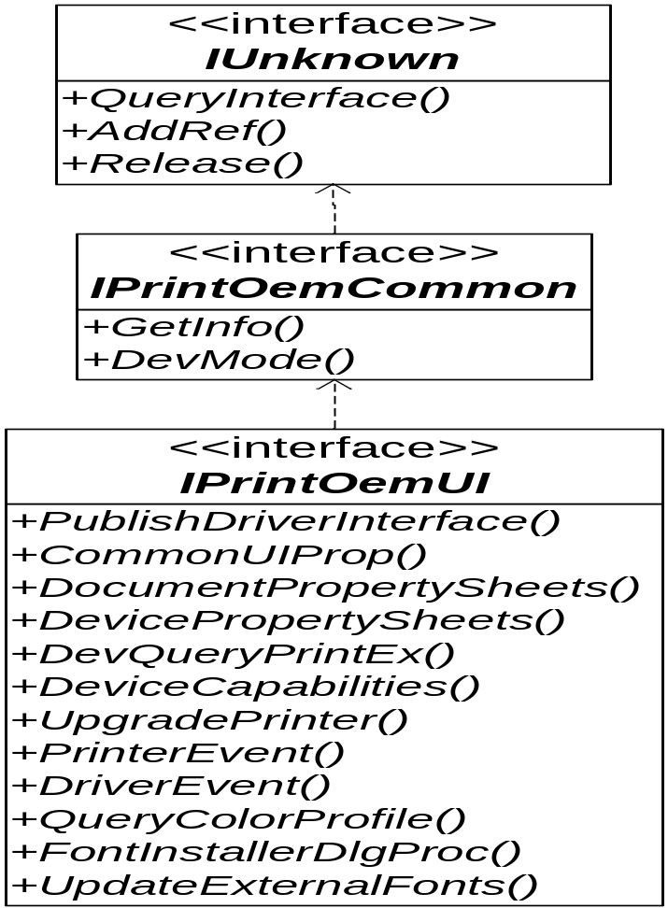

UI Plug-ins
Interface
  IPrintOemUI
Notes:
WinHEC 2006
© 2006 Microsoft Corporation. All rights reserved. Microsoft, Windows, Windows Vista and other product names are or may be registered trademarks and/or trademarks in the U.S. and/or other countries.
The information herein is for informational purposes only and represents the current view of Microsoft Corporation as of the date of this presentation. Because Microsoft must respond to changing market conditions, it should not be interpreted to be a commitment on the part of Microsoft, and Microsoft cannot guarantee the accuracy of any information provided after the date of this presentation.
MICROSOFT MAKES NO WARRANTIES, EXPRESS, IMPLIED OR STATUTORY, AS TO THE INFORMATION IN THIS PRESENTATION.

Slide 10
UI Plug-ins
Interface
  IPrintOemUI
Method | Description
IPrintOemUI::CommonUIProp | Allows a user interface plug-in to modify an existing printer property sheet page or document property sheet page.
IPrintOemUI::DeviceCapabilities | Allows a user interface plug-in to specify customized device capabilities.
IPrintOemUI::DevicePropertySheets | Allows a user interface plug-in to add a new page to a printer device's printer property sheet.
Notes:
WinHEC 2006
© 2006 Microsoft Corporation. All rights reserved. Microsoft, Windows, Windows Vista and other product names are or may be registered trademarks and/or trademarks in the U.S. and/or other countries.
The information herein is for informational purposes only and represents the current view of Microsoft Corporation as of the date of this presentation. Because Microsoft must respond to changing market conditions, it should not be interpreted to be a commitment on the part of Microsoft, and Microsoft cannot guarantee the accuracy of any information provided after the date of this presentation.
MICROSOFT MAKES NO WARRANTIES, EXPRESS, IMPLIED OR STATUTORY, AS TO THE INFORMATION IN THIS PRESENTATION.

Slide 11
UI Plug-ins
Interface
  IPrintOemUI
Method | Description
IPrintOemUI::DevMode | Performs operations on a user interface plug-in's private DEVMODEW members.
IPrintOemUI::DevQueryPrintEx | Allows a user interface plug-in to help determine if a print job is printable.
IPrintOemUI::DocumentPropertySheets | Allows a user interface plug-in to add a new page to a printer device's document property sheet.
Notes:
WinHEC 2006
© 2006 Microsoft Corporation. All rights reserved. Microsoft, Windows, Windows Vista and other product names are or may be registered trademarks and/or trademarks in the U.S. and/or other countries.
The information herein is for informational purposes only and represents the current view of Microsoft Corporation as of the date of this presentation. Because Microsoft must respond to changing market conditions, it should not be interpreted to be a commitment on the part of Microsoft, and Microsoft cannot guarantee the accuracy of any information provided after the date of this presentation.
MICROSOFT MAKES NO WARRANTIES, EXPRESS, IMPLIED OR STATUTORY, AS TO THE INFORMATION IN THIS PRESENTATION.

Slide 12
UI Plug-ins
Interface
  IPrintOemUI
Method | Description
IPrintOemUI::DriverEvent | Called by the print spooler when processing driver-specific events that might require action by the printer driver.
IPrintOemUI::FontInstallerDlgProc | Replaces the Unidrv font installer's user interface.
IPrintOemUI::GetInfo | (Implementation required.) Returns a user interface plug-in's identification information
Notes:
WinHEC 2006
© 2006 Microsoft Corporation. All rights reserved. Microsoft, Windows, Windows Vista and other product names are or may be registered trademarks and/or trademarks in the U.S. and/or other countries.
The information herein is for informational purposes only and represents the current view of Microsoft Corporation as of the date of this presentation. Because Microsoft must respond to changing market conditions, it should not be interpreted to be a commitment on the part of Microsoft, and Microsoft cannot guarantee the accuracy of any information provided after the date of this presentation.
MICROSOFT MAKES NO WARRANTIES, EXPRESS, IMPLIED OR STATUTORY, AS TO THE INFORMATION IN THIS PRESENTATION.

Slide 13
UI Plug-ins
Interface
  IPrintOemUI
Method | Description
IPrintOemUI::PrinterEvent | Allows a user interface plug-in to process printer events.
IPrintOemUI::PublishDriverInterface | (Implementation required.) Supplies a pointer to the Unidrv or Pscript5 driver's IPrintOemDriverUI COM interface, IPrintCoreUI2 COM interface, IPrintCoreHelperPS interface, or IPrintCoreHelperUni interface.
IPrintOemUI::QueryColorProfile | Allows a printer interface DLL to specify an ICC profile to use for color management.
Notes:
WinHEC 2006
© 2006 Microsoft Corporation. All rights reserved. Microsoft, Windows, Windows Vista and other product names are or may be registered trademarks and/or trademarks in the U.S. and/or other countries.
The information herein is for informational purposes only and represents the current view of Microsoft Corporation as of the date of this presentation. Because Microsoft must respond to changing market conditions, it should not be interpreted to be a commitment on the part of Microsoft, and Microsoft cannot guarantee the accuracy of any information provided after the date of this presentation.
MICROSOFT MAKES NO WARRANTIES, EXPRESS, IMPLIED OR STATUTORY, AS TO THE INFORMATION IN THIS PRESENTATION.

Slide 14
UI Plug-ins
Interface
  IPrintOemUI
Method | Description
IPrintOemUI::UpdateExternalFonts | Allows a printer interface DLL to update a printer's Unidrv font format files.
IPrintOemUI::UpgradePrinter | Allows a user interface plug-in to upgrade device option values that are stored in the registry.
Notes:
WinHEC 2006
© 2006 Microsoft Corporation. All rights reserved. Microsoft, Windows, Windows Vista and other product names are or may be registered trademarks and/or trademarks in the U.S. and/or other countries.
The information herein is for informational purposes only and represents the current view of Microsoft Corporation as of the date of this presentation. Because Microsoft must respond to changing market conditions, it should not be interpreted to be a commitment on the part of Microsoft, and Microsoft cannot guarantee the accuracy of any information provided after the date of this presentation.
MICROSOFT MAKES NO WARRANTIES, EXPRESS, IMPLIED OR STATUTORY, AS TO THE INFORMATION IN THIS PRESENTATION.

Slide 15
UI Plug-ins
Interface
  IPrintOemUI
  IPrintOemUI::PublishDriverInterface
  The IPrintOemUI::PublishDriverInterface method allows a user interface plug-in to obtain the Unidrv or Pscript5 driver's IPrintOemDriverUI, IPrintCoreUI2, IPrintCoreHelperPS, or IPrintCoreHelperUni interface.

Slide 16
UI Plug-ins
Interface
  IPrintOemUI
  IPrintOemUI::CommonUIProp
  The IPrintOemUI::CommonUIProp method allows a user interface plug-in to modify an existing printer property sheet page.

Slide 17
UI Plug-ins
Interface
  IPrintOemUI
  IPrintOemUI::DocumentPropertySheets
  The IPrintOemUI::DocumentPropertySheets method allows a user interface plug-in to append a new page to a printer device's document property sheet.

Slide 18
UI Plug-ins
Interface
  IPrintOemUI
  IPrintOemUI::DevicePropertySheets
  The IPrintOemUI::DevicePropertySheets method allows a user interface plug-in to append a new page to a printer device's printer property sheet.

Slide 19
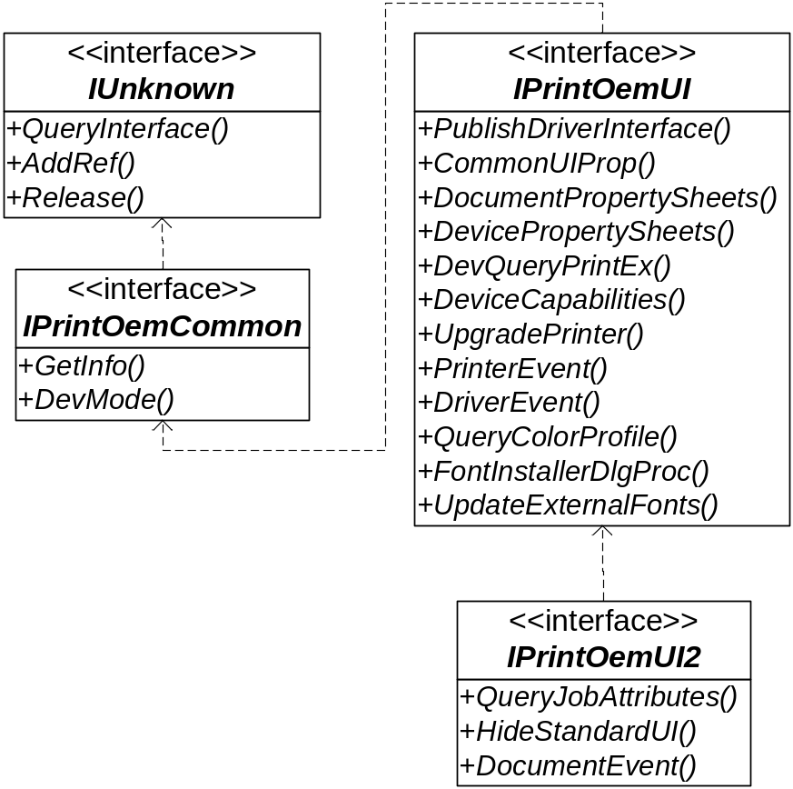
UI Plug-ins
Interface
  IPrintOemUI2
Notes:
WinHEC 2006
© 2006 Microsoft Corporation. All rights reserved. Microsoft, Windows, Windows Vista and other product names are or may be registered trademarks and/or trademarks in the U.S. and/or other countries.
The information herein is for informational purposes only and represents the current view of Microsoft Corporation as of the date of this presentation. Because Microsoft must respond to changing market conditions, it should not be interpreted to be a commitment on the part of Microsoft, and Microsoft cannot guarantee the accuracy of any information provided after the date of this presentation.
MICROSOFT MAKES NO WARRANTIES, EXPRESS, IMPLIED OR STATUTORY, AS TO THE INFORMATION IN THIS PRESENTATION.

Slide 20
UI Plug-ins
Interface
  IPrintOemUI2
Method | Description
IPrintOemUI2::DocumentEvent | Allows a UI plug-in to replace the core driver UI module's default implementation of the DrvDocumentEvent DDI.
IPrintOemUI2::HideStandardUI | Allows a UI plug-in to specify whether the standard property sheets should be displayed or hidden.
IPrintOemUI2::QueryJobAttributes | Allows a UI plug-in to post-process the core driver's results after a call to the DrvQueryJobAttributes DDI.
Notes:
WinHEC 2006
© 2006 Microsoft Corporation. All rights reserved. Microsoft, Windows, Windows Vista and other product names are or may be registered trademarks and/or trademarks in the U.S. and/or other countries.
The information herein is for informational purposes only and represents the current view of Microsoft Corporation as of the date of this presentation. Because Microsoft must respond to changing market conditions, it should not be interpreted to be a commitment on the part of Microsoft, and Microsoft cannot guarantee the accuracy of any information provided after the date of this presentation.
MICROSOFT MAKES NO WARRANTIES, EXPRESS, IMPLIED OR STATUTORY, AS TO THE INFORMATION IN THIS PRESENTATION.

Slide 21
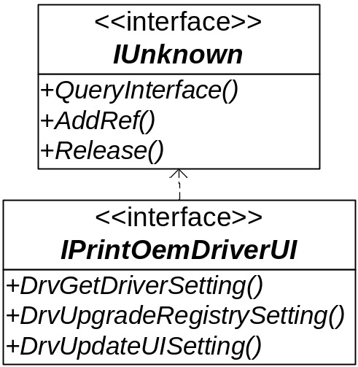
UI Plug-ins
Interface
  IPrintOemDriverUI
Notes:
WinHEC 2006
© 2006 Microsoft Corporation. All rights reserved. Microsoft, Windows, Windows Vista and other product names are or may be registered trademarks and/or trademarks in the U.S. and/or other countries.
The information herein is for informational purposes only and represents the current view of Microsoft Corporation as of the date of this presentation. Because Microsoft must respond to changing market conditions, it should not be interpreted to be a commitment on the part of Microsoft, and Microsoft cannot guarantee the accuracy of any information provided after the date of this presentation.
MICROSOFT MAKES NO WARRANTIES, EXPRESS, IMPLIED OR STATUTORY, AS TO THE INFORMATION IN THIS PRESENTATION.

Slide 22
UI Plug-ins
Interface
  IPrintOemDriverUI
Method | Description
IPrintOemDriverUI::DrvGetDriverSetting | Allows a user interface plug-in to obtain the current status of printer features and other internal information.
IPrintOemDriverUI::DrvUpdateUISetting | Allows a user interface plug-in to notify the driver of a modified user interface option.
IPrintOemDriverUI::DrvUpgradeRegistrySetting | Allows a user interface plug-in to update device settings stored in the registry.
Notes:
WinHEC 2006
© 2006 Microsoft Corporation. All rights reserved. Microsoft, Windows, Windows Vista and other product names are or may be registered trademarks and/or trademarks in the U.S. and/or other countries.
The information herein is for informational purposes only and represents the current view of Microsoft Corporation as of the date of this presentation. Because Microsoft must respond to changing market conditions, it should not be interpreted to be a commitment on the part of Microsoft, and Microsoft cannot guarantee the accuracy of any information provided after the date of this presentation.
MICROSOFT MAKES NO WARRANTIES, EXPRESS, IMPLIED OR STATUTORY, AS TO THE INFORMATION IN THIS PRESENTATION.

Slide 23
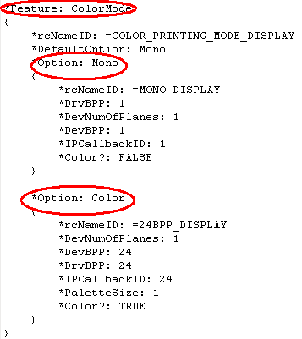
UI Plug-ins
Interface
  IPrintOemDriverUI
Notes:
WinHEC 2006
© 2006 Microsoft Corporation. All rights reserved. Microsoft, Windows, Windows Vista and other product names are or may be registered trademarks and/or trademarks in the U.S. and/or other countries.
The information herein is for informational purposes only and represents the current view of Microsoft Corporation as of the date of this presentation. Because Microsoft must respond to changing market conditions, it should not be interpreted to be a commitment on the part of Microsoft, and Microsoft cannot guarantee the accuracy of any information provided after the date of this presentation.
MICROSOFT MAKES NO WARRANTIES, EXPRESS, IMPLIED OR STATUTORY, AS TO THE INFORMATION IN THIS PRESENTATION.

Slide 24
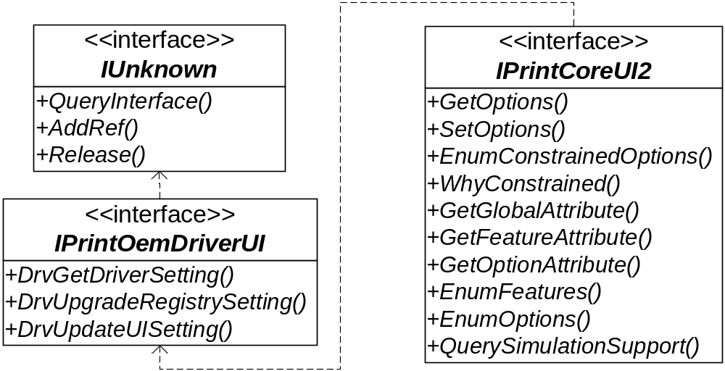
UI Plug-ins
Interface
  IPrintCoreUI2 (Pscript5 Only)
Notes:
WinHEC 2006
© 2006 Microsoft Corporation. All rights reserved. Microsoft, Windows, Windows Vista and other product names are or may be registered trademarks and/or trademarks in the U.S. and/or other countries.
The information herein is for informational purposes only and represents the current view of Microsoft Corporation as of the date of this presentation. Because Microsoft must respond to changing market conditions, it should not be interpreted to be a commitment on the part of Microsoft, and Microsoft cannot guarantee the accuracy of any information provided after the date of this presentation.
MICROSOFT MAKES NO WARRANTIES, EXPRESS, IMPLIED OR STATUTORY, AS TO THE INFORMATION IN THIS PRESENTATION.

Slide 25
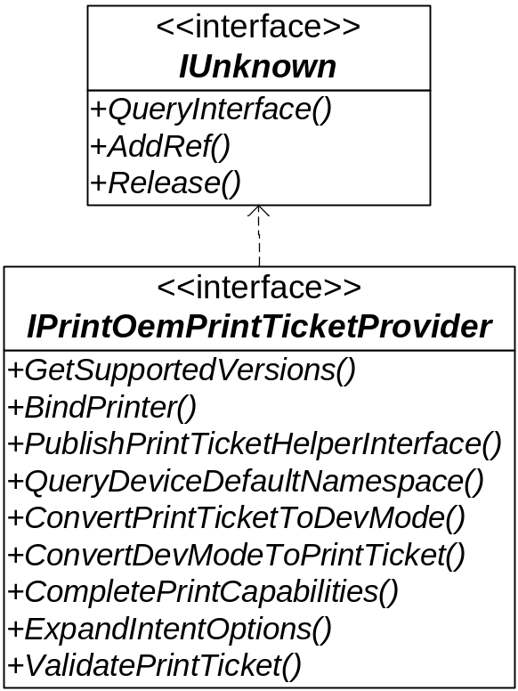
UI Plug-ins
Interface
  IPrintOemPrintTicketProvider
Notes:
WinHEC 2006
© 2006 Microsoft Corporation. All rights reserved. Microsoft, Windows, Windows Vista and other product names are or may be registered trademarks and/or trademarks in the U.S. and/or other countries.
The information herein is for informational purposes only and represents the current view of Microsoft Corporation as of the date of this presentation. Because Microsoft must respond to changing market conditions, it should not be interpreted to be a commitment on the part of Microsoft, and Microsoft cannot guarantee the accuracy of any information provided after the date of this presentation.
MICROSOFT MAKES NO WARRANTIES, EXPRESS, IMPLIED OR STATUTORY, AS TO THE INFORMATION IN THIS PRESENTATION.

Slide 26
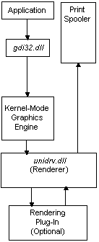
Render plug-ins
Introduction
  COM-Based Rendering Functions
  Unidrv: IPrintOemUni
  Pscript5: IPrintOemPS
  Non-COM-Based Rendering Functions
  OEMAlphaBlend,OEMBitBlt,OEMCopyBits,OEMStartDoc,OEMLineTo, OEMStartPage, OEMEndDoc, OEMSendPage
  For more information, please reference the “DDK/Non-COM-Based DDI Hook-out Functions”
Notes:
WinHEC 2006
© 2006 Microsoft Corporation. All rights reserved. Microsoft, Windows, Windows Vista and other product names are or may be registered trademarks and/or trademarks in the U.S. and/or other countries.
The information herein is for informational purposes only and represents the current view of Microsoft Corporation as of the date of this presentation. Because Microsoft must respond to changing market conditions, it should not be interpreted to be a commitment on the part of Microsoft, and Microsoft cannot guarantee the accuracy of any information provided after the date of this presentation.
MICROSOFT MAKES NO WARRANTIES, EXPRESS, IMPLIED OR STATUTORY, AS TO THE INFORMATION IN THIS PRESENTATION.

Slide 27
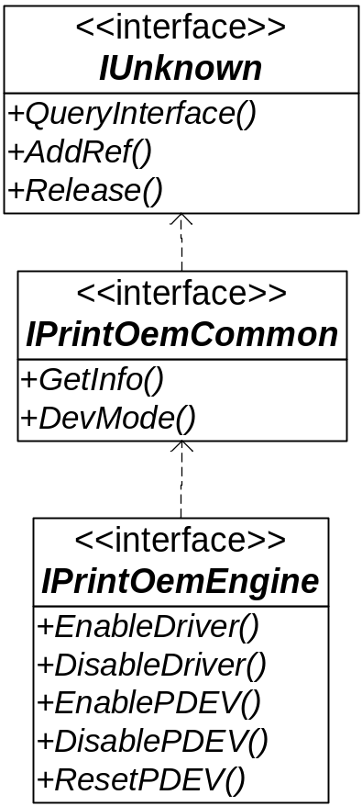
Render plug-ins
COM-Based Interface
  IPrintOemEngine
Notes:
WinHEC 2006
© 2006 Microsoft Corporation. All rights reserved. Microsoft, Windows, Windows Vista and other product names are or may be registered trademarks and/or trademarks in the U.S. and/or other countries.
The information herein is for informational purposes only and represents the current view of Microsoft Corporation as of the date of this presentation. Because Microsoft must respond to changing market conditions, it should not be interpreted to be a commitment on the part of Microsoft, and Microsoft cannot guarantee the accuracy of any information provided after the date of this presentation.
MICROSOFT MAKES NO WARRANTIES, EXPRESS, IMPLIED OR STATUTORY, AS TO THE INFORMATION IN THIS PRESENTATION.

Slide 28
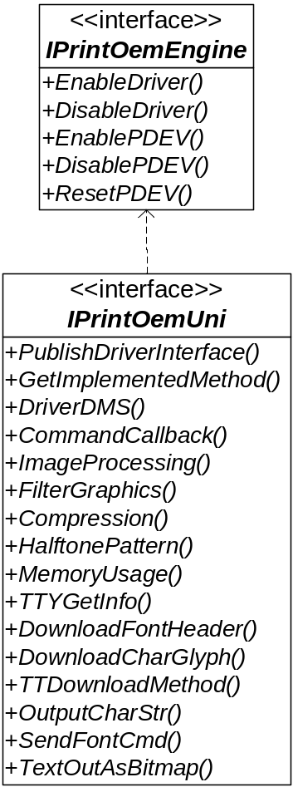
Render plug-ins
COM-Based Interface
  IPrintOemUni
Notes:
WinHEC 2006
© 2006 Microsoft Corporation. All rights reserved. Microsoft, Windows, Windows Vista and other product names are or may be registered trademarks and/or trademarks in the U.S. and/or other countries.
The information herein is for informational purposes only and represents the current view of Microsoft Corporation as of the date of this presentation. Because Microsoft must respond to changing market conditions, it should not be interpreted to be a commitment on the part of Microsoft, and Microsoft cannot guarantee the accuracy of any information provided after the date of this presentation.
MICROSOFT MAKES NO WARRANTIES, EXPRESS, IMPLIED OR STATUTORY, AS TO THE INFORMATION IN THIS PRESENTATION.

Slide 29
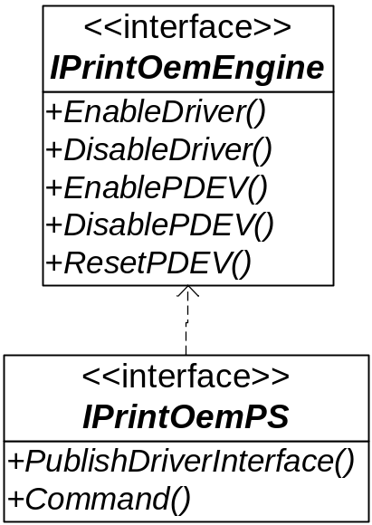
Render plug-ins
COM-Based Interface
  IPrintOemPS
Notes:
WinHEC 2006
© 2006 Microsoft Corporation. All rights reserved. Microsoft, Windows, Windows Vista and other product names are or may be registered trademarks and/or trademarks in the U.S. and/or other countries.
The information herein is for informational purposes only and represents the current view of Microsoft Corporation as of the date of this presentation. Because Microsoft must respond to changing market conditions, it should not be interpreted to be a commitment on the part of Microsoft, and Microsoft cannot guarantee the accuracy of any information provided after the date of this presentation.
MICROSOFT MAKES NO WARRANTIES, EXPRESS, IMPLIED OR STATUTORY, AS TO THE INFORMATION IN THIS PRESENTATION.

Slide 30
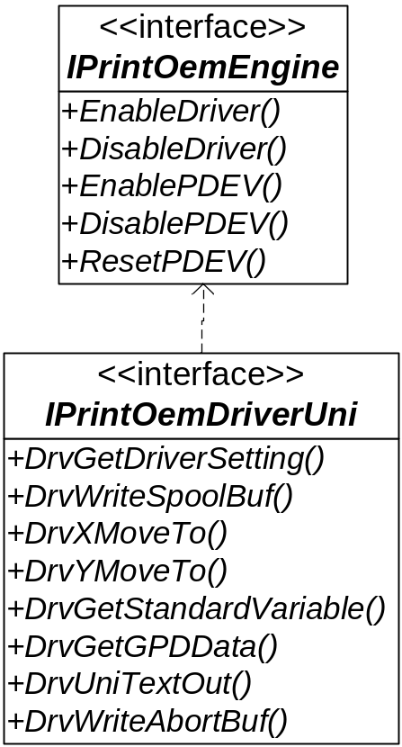
Render plug-ins
COM-Based Interface
  IPrintOemDriverUni
Notes:
WinHEC 2006
© 2006 Microsoft Corporation. All rights reserved. Microsoft, Windows, Windows Vista and other product names are or may be registered trademarks and/or trademarks in the U.S. and/or other countries.
The information herein is for informational purposes only and represents the current view of Microsoft Corporation as of the date of this presentation. Because Microsoft must respond to changing market conditions, it should not be interpreted to be a commitment on the part of Microsoft, and Microsoft cannot guarantee the accuracy of any information provided after the date of this presentation.
MICROSOFT MAKES NO WARRANTIES, EXPRESS, IMPLIED OR STATUTORY, AS TO THE INFORMATION IN THIS PRESENTATION.

Slide 31
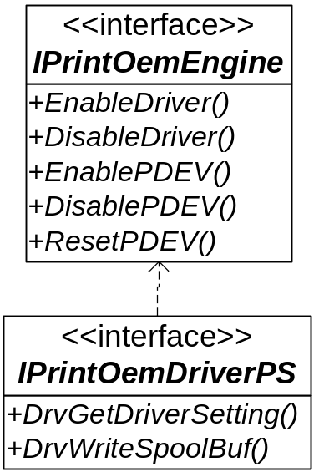
Render plug-ins
COM-Based Interface
  IPrintOemDriverPS
Notes:
WinHEC 2006
© 2006 Microsoft Corporation. All rights reserved. Microsoft, Windows, Windows Vista and other product names are or may be registered trademarks and/or trademarks in the U.S. and/or other countries.
The information herein is for informational purposes only and represents the current view of Microsoft Corporation as of the date of this presentation. Because Microsoft must respond to changing market conditions, it should not be interpreted to be a commitment on the part of Microsoft, and Microsoft cannot guarantee the accuracy of any information provided after the date of this presentation.
MICROSOFT MAKES NO WARRANTIES, EXPRESS, IMPLIED OR STATUTORY, AS TO THE INFORMATION IN THIS PRESENTATION.

Slide 32
Render plug-ins
Non-COM-Based Interface
  OEMStartDoc
  OEMStartPage
  OEMSendPage
  OEMEndDoc
Notes:
WinHEC 2006
© 2006 Microsoft Corporation. All rights reserved. Microsoft, Windows, Windows Vista and other product names are or may be registered trademarks and/or trademarks in the U.S. and/or other countries.
The information herein is for informational purposes only and represents the current view of Microsoft Corporation as of the date of this presentation. Because Microsoft must respond to changing market conditions, it should not be interpreted to be a commitment on the part of Microsoft, and Microsoft cannot guarantee the accuracy of any information provided after the date of this presentation.
MICROSOFT MAKES NO WARRANTIES, EXPRESS, IMPLIED OR STATUTORY, AS TO THE INFORMATION IN THIS PRESENTATION.

Slide 33
IPrintCoreHelper for Plug-Ins
Introduction
The IPrintCoreHelper interface provides a basic set of functionality that is available to all four core driver modules: Unidrv rendering plug-ins, Unidrv UI plug-ins, Pscript5 rendering plug-ins, and Pscript5 UI plug-ins.
The IPrintCoreHelper interface is the base interface from which the IPrintCoreHelperPS and IPrintCoreHelperUni interfaces inherit. Developers of Pscript5 plug-ins should implement the IPrintCoreHelperPS interface. Developers of Unidrv plug-ins should implement the IPrintCoreHelperUni interface.
Notes:
WinHEC 2006
© 2006 Microsoft Corporation. All rights reserved. Microsoft, Windows, Windows Vista and other product names are or may be registered trademarks and/or trademarks in the U.S. and/or other countries.
The information herein is for informational purposes only and represents the current view of Microsoft Corporation as of the date of this presentation. Because Microsoft must respond to changing market conditions, it should not be interpreted to be a commitment on the part of Microsoft, and Microsoft cannot guarantee the accuracy of any information provided after the date of this presentation.
MICROSOFT MAKES NO WARRANTIES, EXPRESS, IMPLIED OR STATUTORY, AS TO THE INFORMATION IN THIS PRESENTATION.

Slide 34
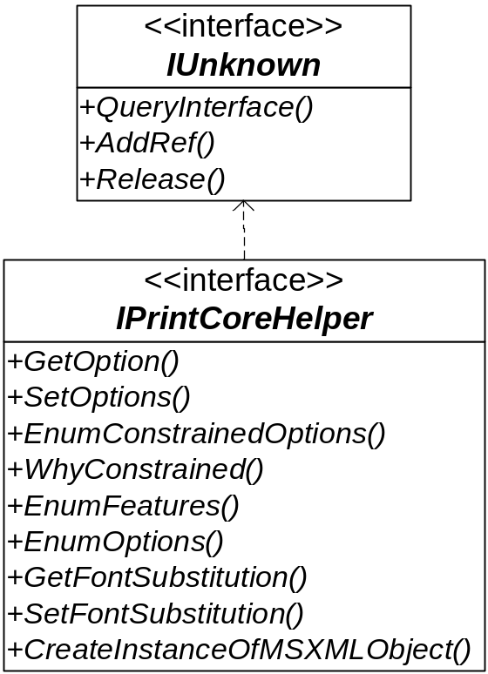
IPrintCoreHelper for Plug-Ins
Interface
  IPrintCoreHelper
Notes:
WinHEC 2006
© 2006 Microsoft Corporation. All rights reserved. Microsoft, Windows, Windows Vista and other product names are or may be registered trademarks and/or trademarks in the U.S. and/or other countries.
The information herein is for informational purposes only and represents the current view of Microsoft Corporation as of the date of this presentation. Because Microsoft must respond to changing market conditions, it should not be interpreted to be a commitment on the part of Microsoft, and Microsoft cannot guarantee the accuracy of any information provided after the date of this presentation.
MICROSOFT MAKES NO WARRANTIES, EXPRESS, IMPLIED OR STATUTORY, AS TO THE INFORMATION IN THIS PRESENTATION.

Slide 35
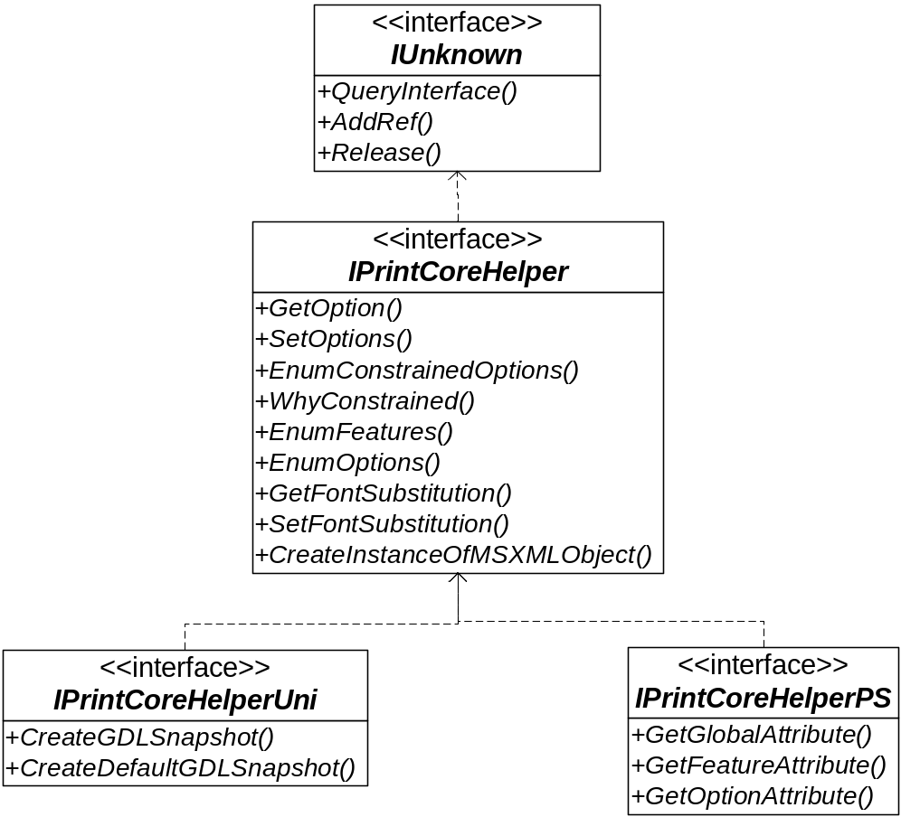
IPrintCoreHelper for Plug-Ins
Interface
  IPrintCoreHelperUni IPrintCoreHelperPS
Notes:
WinHEC 2006
© 2006 Microsoft Corporation. All rights reserved. Microsoft, Windows, Windows Vista and other product names are or may be registered trademarks and/or trademarks in the U.S. and/or other countries.
The information herein is for informational purposes only and represents the current view of Microsoft Corporation as of the date of this presentation. Because Microsoft must respond to changing market conditions, it should not be interpreted to be a commitment on the part of Microsoft, and Microsoft cannot guarantee the accuracy of any information provided after the date of this presentation.
MICROSOFT MAKES NO WARRANTIES, EXPRESS, IMPLIED OR STATUTORY, AS TO THE INFORMATION IN THIS PRESENTATION.

Slide 36
Release
INF
  CopyFiles=@Plugin.ini
  RenderPlugin.dll UIPlugin.dll
Configuration file
  [OEMFiles]
  OEMDriverFile1=RenderPlugin.dll
  OEMConfigFile1=UIPlugin.dll
Notes:
WinHEC 2006
© 2006 Microsoft Corporation. All rights reserved. Microsoft, Windows, Windows Vista and other product names are or may be registered trademarks and/or trademarks in the U.S. and/or other countries.
The information herein is for informational purposes only and represents the current view of Microsoft Corporation as of the date of this presentation. Because Microsoft must respond to changing market conditions, it should not be interpreted to be a commitment on the part of Microsoft, and Microsoft cannot guarantee the accuracy of any information provided after the date of this presentation.
MICROSOFT MAKES NO WARRANTIES, EXPRESS, IMPLIED OR STATUTORY, AS TO THE INFORMATION IN THIS PRESENTATION.

